Slide 1
Comparing Gait Metrics for Parkinson’s Disease Diagnosis
Kaustav Malik

Slide 2

Parkinson’s Disease
Progressive, Neurodegenerative disorder
Affecting 7-10M people worldwide
Generally males over the age of 65
Notes:
https://parkinsonsnewstoday.com/parkinsons-disease-statistics/
https://www.mayoclinic.org/diseases-conditions/parkinsons-disease/symptoms-causes/syc-20376055
What they do know is that in Parkinson’s disease something causes the dopamine producing neurons within an area of the brain called the substantia nigra, or midbrain, to degenerate and die.
60,000 new
15% under 50

Slide 3
Noticeable Symptoms
Tremors in extremities
Impaired and slower movements
Muscle stiffness affecting posture and gait
Parkinson’s Gait
Notes:
loss of sense of smell, depression, irregular sleeping patterns, and memory loss
Nevertheless, the most prevalent and noticeable symptoms are all movement related
Typically have tremors in their hands, arms, face or legs,
Slower movements and difficulty performing simple tasks known as bradykinesia
Stiffness within their muscles affecting their posture and gait.
Parkinsonian gait is when a person with Parkinson’s Disease has trouble starting and stopping to walk, as well as difficulty performing the overall motion of walking.

Slide 4
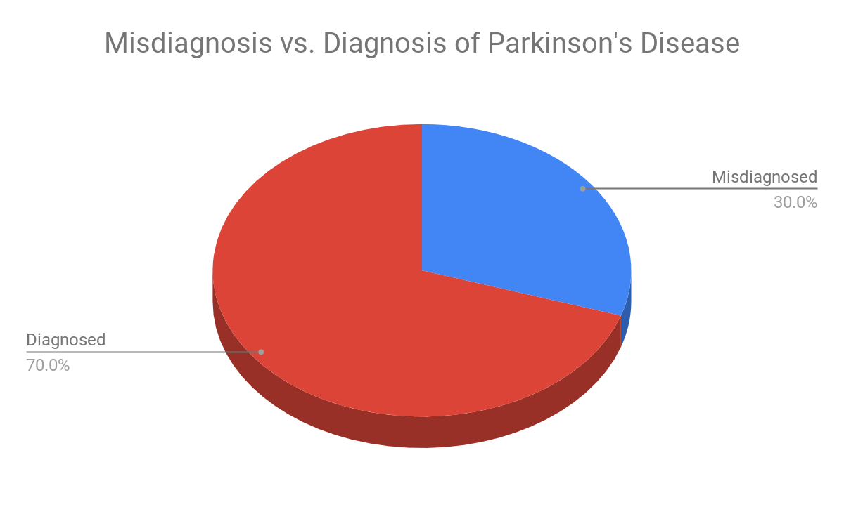
Currently there are no specific tests to diagnose Parkinson’s Disease
Notes:
https://health.clevelandclinic.org/is-your-trembling-caused-by-parkinsons-or-a-condition-that-mimics-it/

Slide 5
Proposal
Develop and compare algorithms to diagnose Parkinson’s disease from gait metrics
Step-time interval
Step-force
Two databases

Slide 6
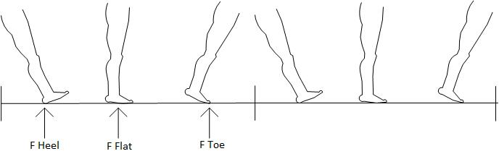
Objective
Step-force vs. Step-time Intervals
Notes:
The objective of this study is to determine if a person’s step force can also be used as a diagnostic tool for predicting Parkinson’s disease. With machine learning, an algorithm will be developed to determine the relationship between the two metrics and PD diagnosis. By comparing these two metrics, it will be determined if step force is as effective or more effective than step-time intervals at predicting PD.

Slide 7
Significance
Neurologists study family & medical history and check for visual signs & symptoms
Finding a correlation between “Step Force” and PD can revolutionize the way doctors diagnose PD

Slide 8
Data Overview
Gait Force
16 force sensors under subjects’ feet measuring gait force at 100 Hz frequency for 2 minutes

Slide 9
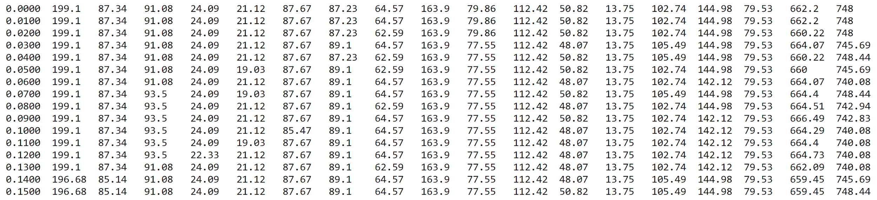
Step Force Data - Gait in Parkinson’s Disease
Time
Stamps
| Force Data Across Feet on each of the 8 sensors on the left foot | Force Data Across Feet on each of the 8 sensors on the right foot | Total Left | Total Right |

Slide 10
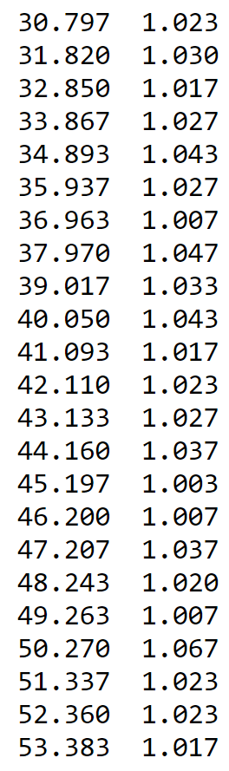
Step Interval - Gait in Aging Database
Column 1: Time stamp (seconds)
Column 2: Step Interval (seconds)

Slide 11
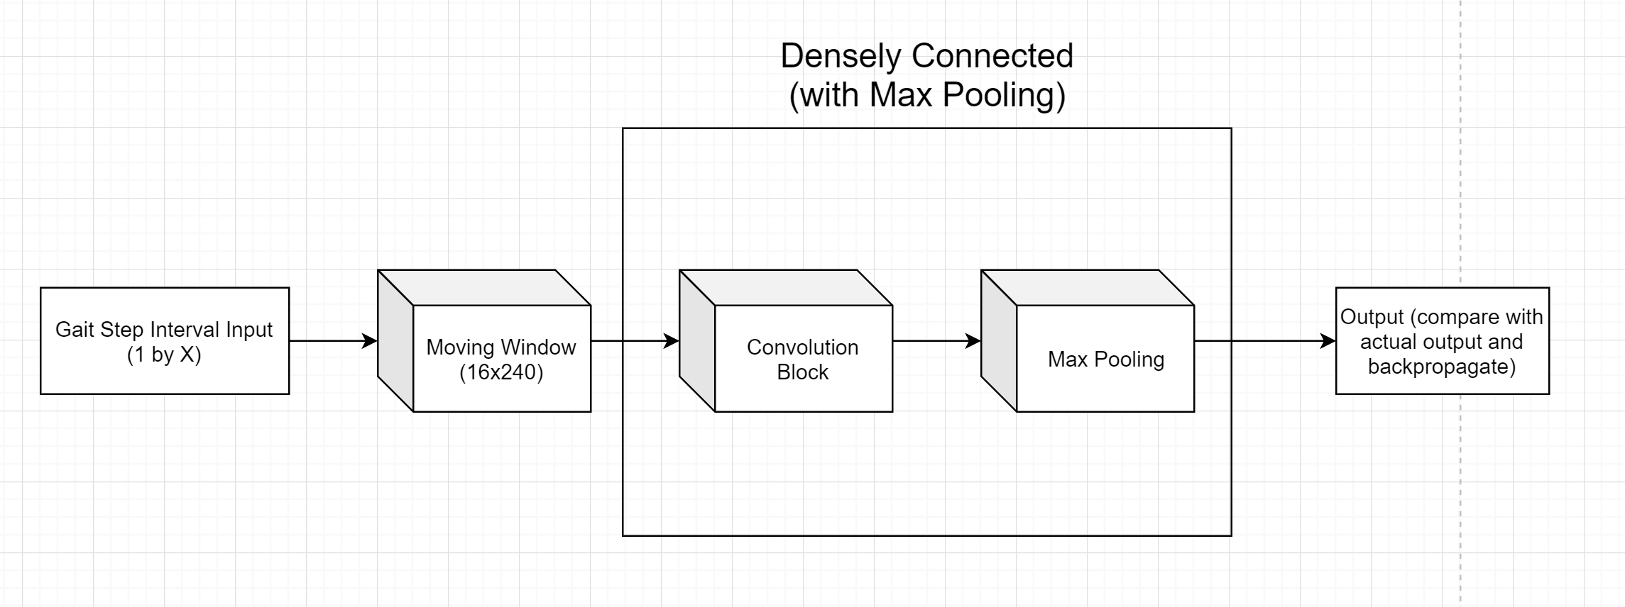
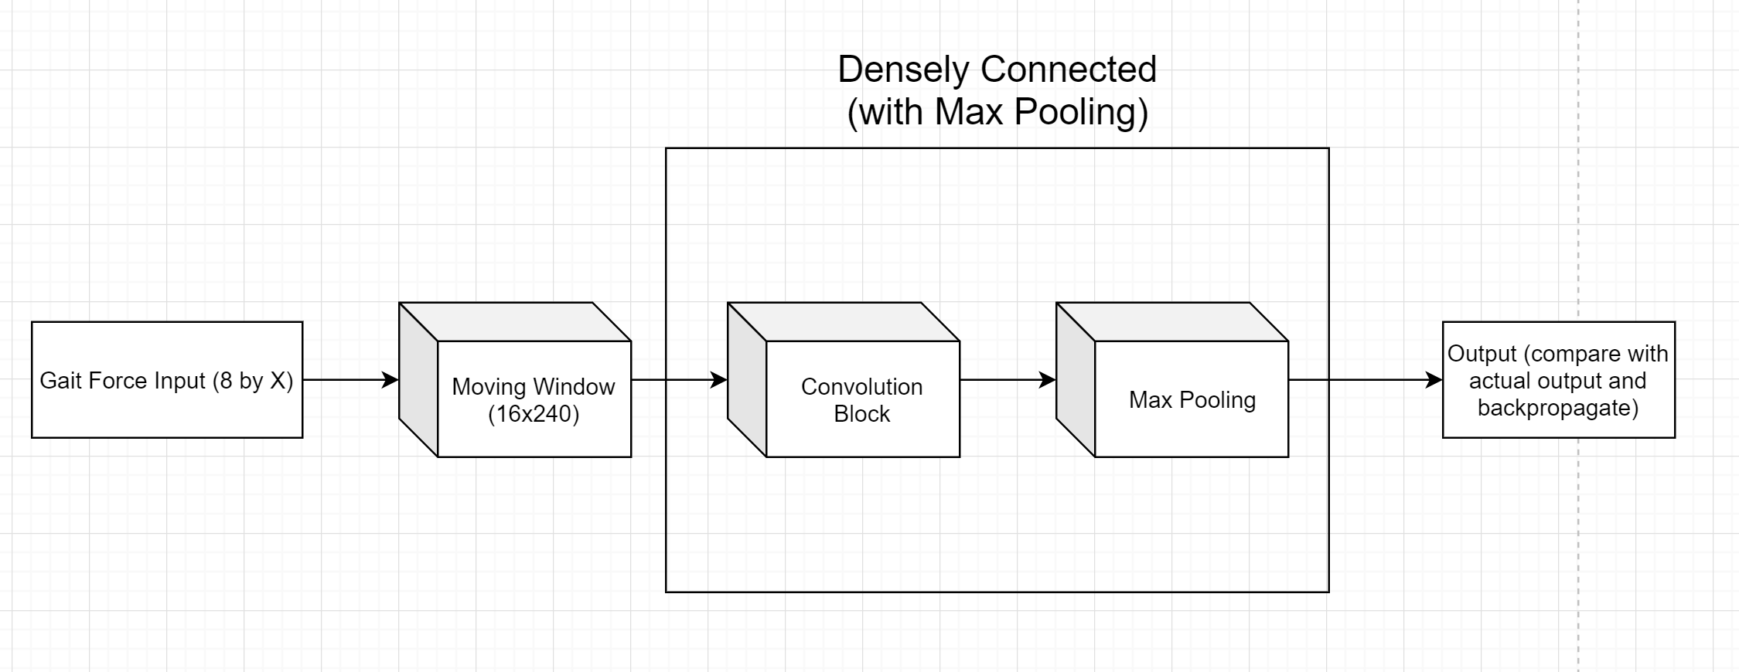
Neural Network Architecture
Convolutional Neural Network
2-dimensional
24 7x7 filters
Training Set
28 control examples
28 PD examples
Test Set
5 control examples
5 PD examples

Slide 12
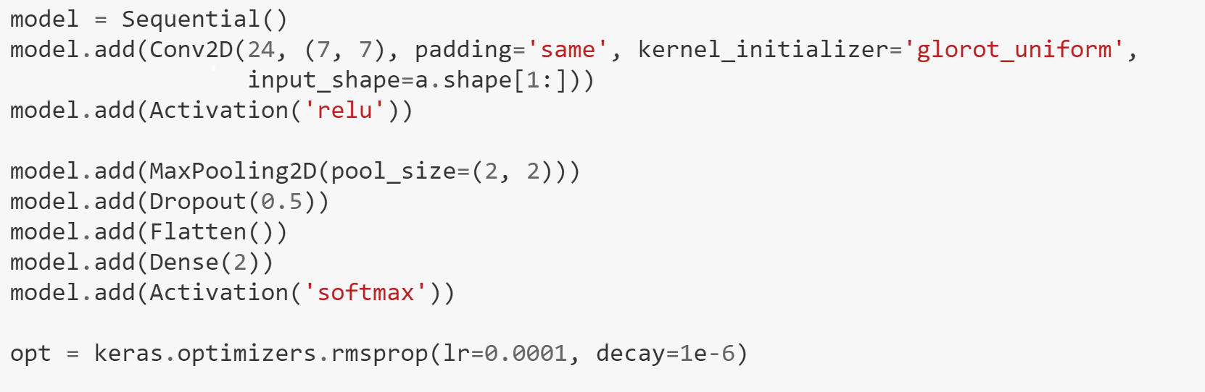
Model Performance
Gait Force
80% accuracy on test set
Gait Step Interval
60% accuracy on test set
Both models performed well considering the data size, but gait force seems to contain more detailed information per training example

Slide 13
Future Directions
If more data were available, this model could be refined and trained longer
Training with other databases
Comparing more metrics
Comparing to other similar diseases
Tracking progression of PD

Slide 14
Questions?

Slide 15
Why CNN and not RNN (LSTM)?
Notes:
Though the data was time series, this is not a sequence prediction problem. Furthermore, a convolutional neural network seemed a better choice for time series classification since LSTMs are more prone to overfitting when handling smaller data sets.

Slide 16
Why these two metrics?
Notes:
Step-time interval is a fairly simple calculation and easily recorded
Step-force hasn’t been analyzed in depth from our research

Slide 17
How did you deal with the different data set sizes?
Notes:
The smaller sample size was broken up into 4 additional samples to counteract the larger sample size of the second database and give us more data.
Smaller sample size: Gait in Aging
Larger sample size: Gait in Parkinson’s Disease

